Slide 1
Quantum Computing Architectures (EE274) Lecture 12
Hiu-Yung Wong
Mar. 4, 2025
hiuyung.wong@sjsu.edu, Office: ENG363
http://www.sjsu.edu/people/hiuyung.wong/index.html

Slide 2
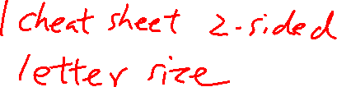
Outline
Spin Rabi Oscillation with Linear Magnetic Field
Spin: Rabi Oscillation with Rotating Magnetic Field
HW 1 Graded. Very lenient; Please check answers to make sure you understand
HW 2 Due this weekend; no late submissions
Midterm Next Week: Cover all materials up to this week.

Slide 3
Rabi Oscillations
Chapter 9 of “Quantum Computing Architecture and Hardware for Engineers: Step by Step”
This part has a lot of maths. You only need to be able to understand and derive them open-book (e.g. for assignment). But you need to understand what I am doing.

Slide 4
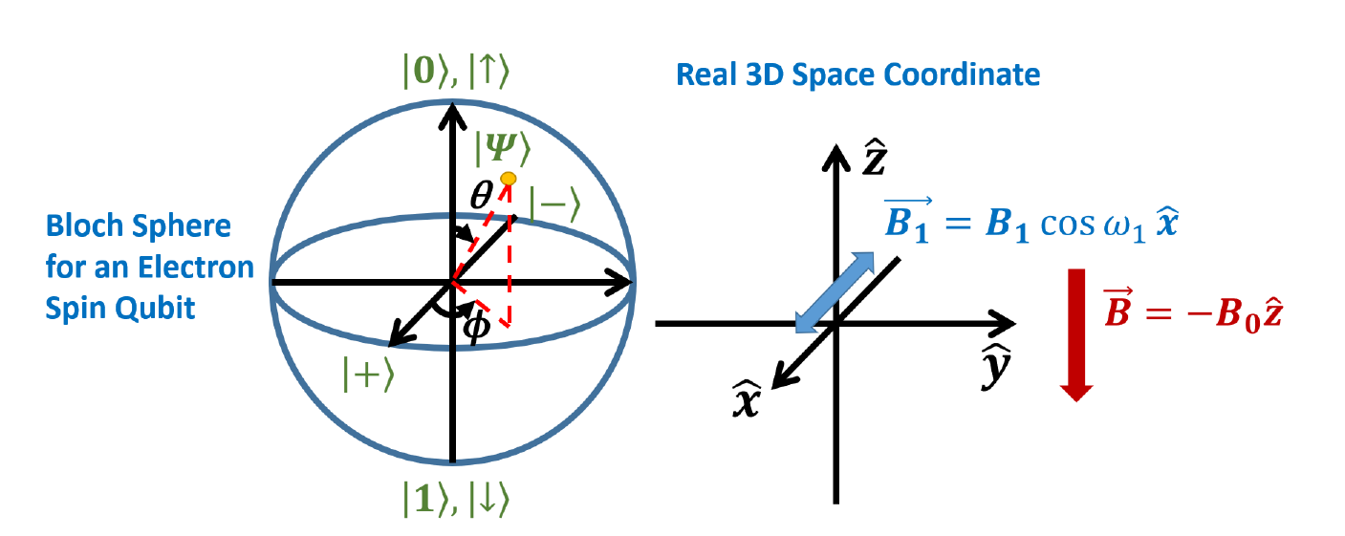
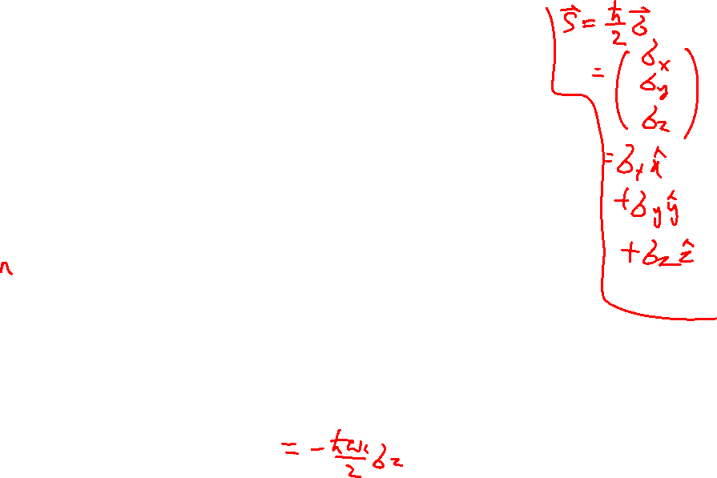
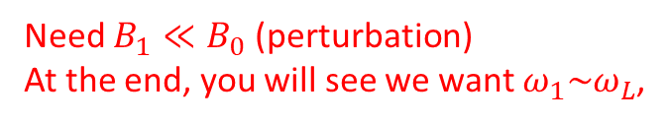
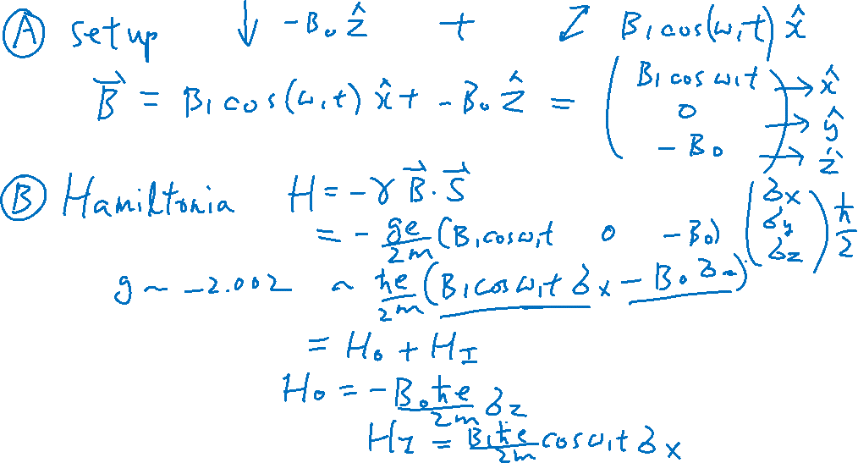
Rabi Oscillation – Experiment Setup
From the Last Lecture
Learning outcomes: Setup
Need $B_{1}≪B_{0}$ (perturbation)
At the end, you will see we want $ω_{1}\sim ω_{L}$,

Slide 5
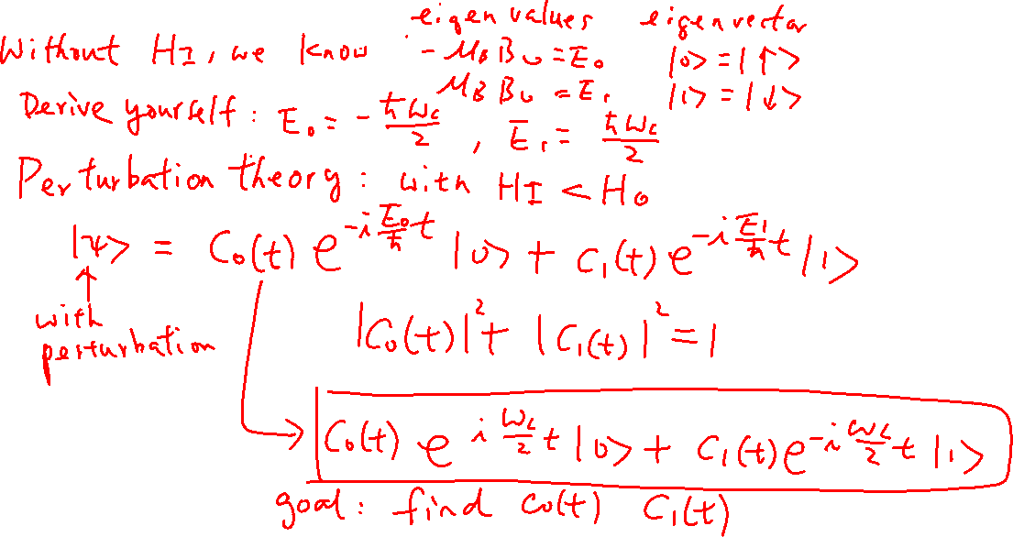
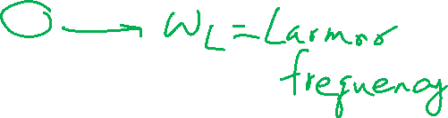
Rabi Oscillation
From the Last Lecture
Learning outcomes: Skill in solving system of differential equations

Slide 6
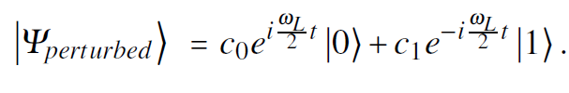
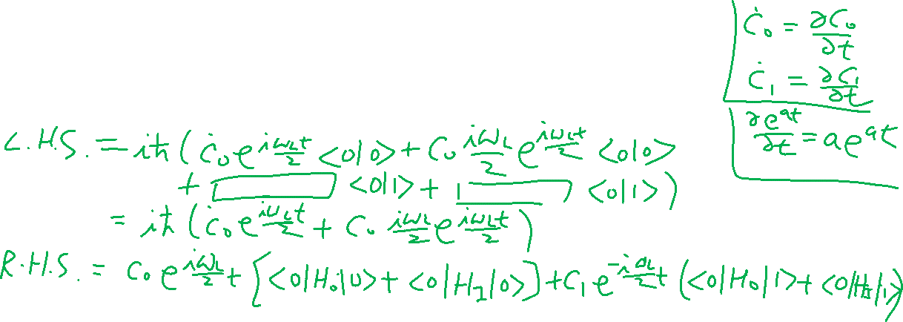
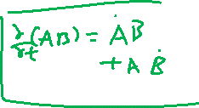
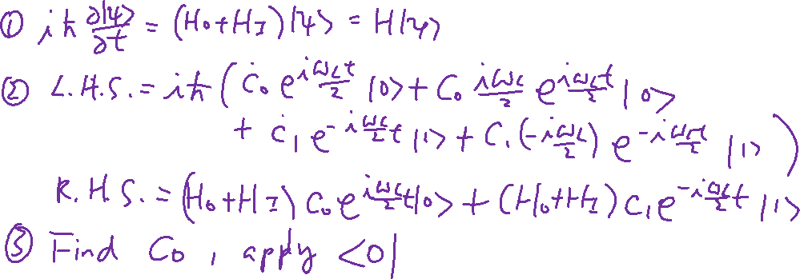
Rabi Oscillation – Solve S.E.
Learning outcomes: Skill in solving system of differential equations

Slide 7
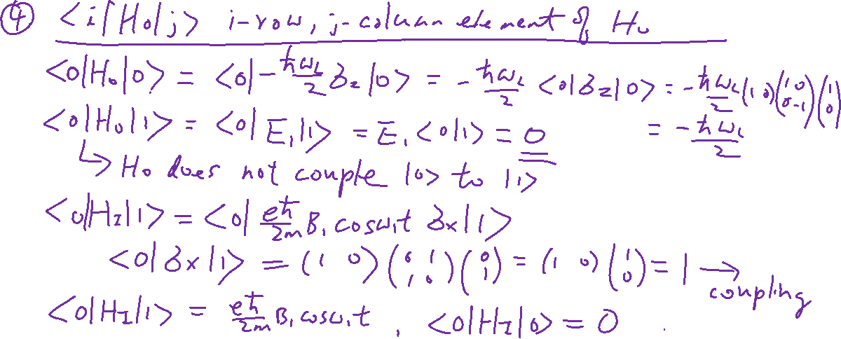
Rabi Oscillation – Solve S.E.
Learning outcomes: Skill in solving system of differential equations

Slide 8
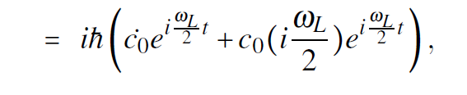
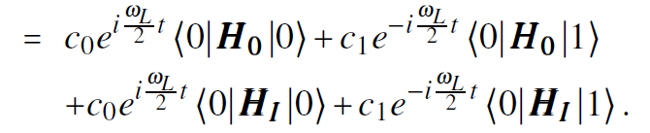
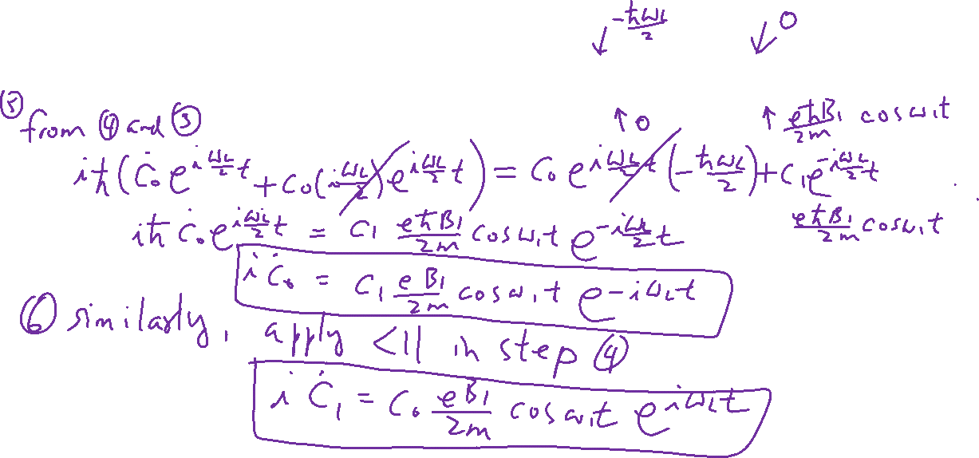
Rabi Oscillation – Solve S.E.
Learning outcomes: Skill in solving system of differential equations
R.H.S
L.H.S

Slide 9


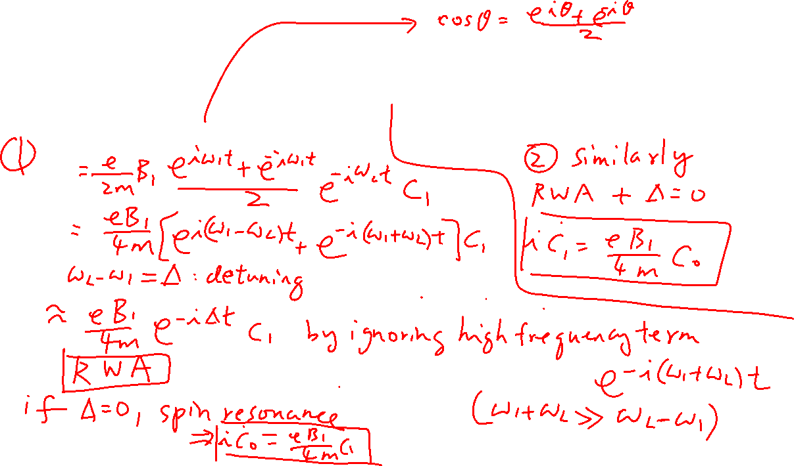
Rotating Wave Approximation (RWA) and Spin Resonance
Learning outcomes: Rotating Wave Approximation

Slide 10
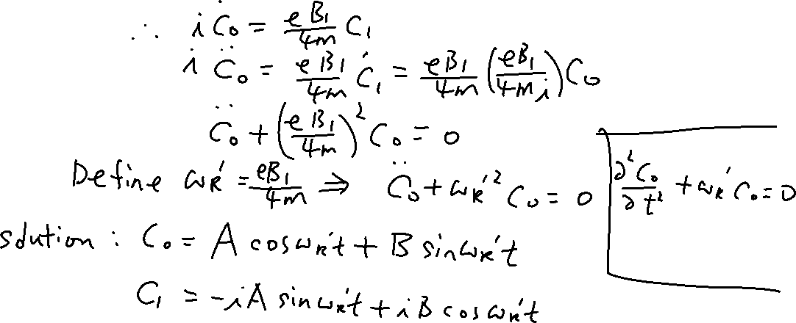
Solution

Slide 11

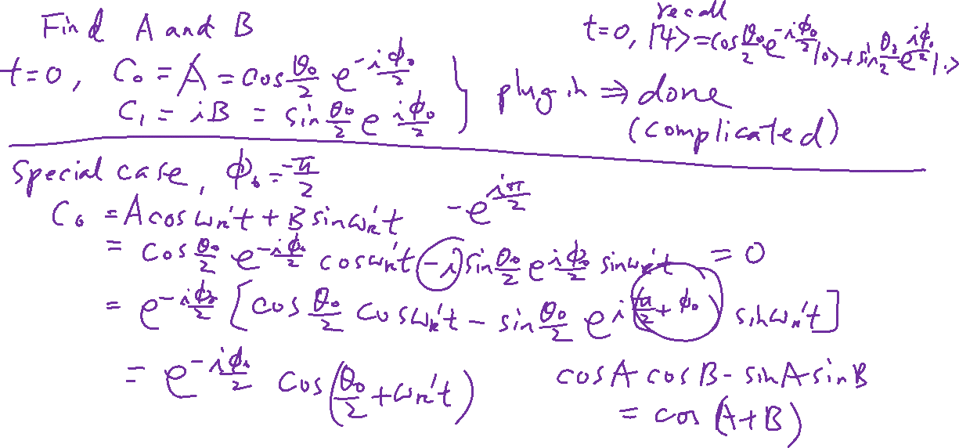
Rabi Oscillation

